Slide 1
Excel Automation using python
Bar-Chart

Slide 2
steps
Open Excel → save file as excel.xlsx
Enter some data and save file
Open VS Code
Create and launch new folder
Open terminal → pip install openpyxl
Type the required code
Get the excel file in VsCode
Run file by using → python excel.py in terminal

Slide 3
steps
Open excel from a1:a10
Enter values 0:9
Save the file as excel.py

Slide 4
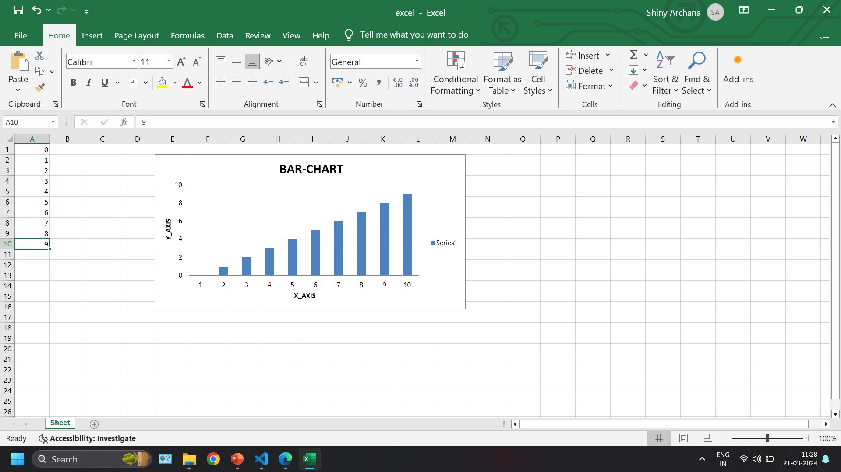
output

Slide 5
Thank - You

